Slide 1
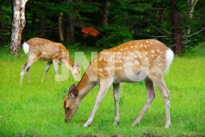
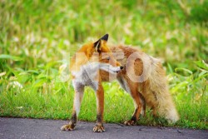
Asahiyama Zoo
Dogs, cats, birds, monkeys
In Asahiyama zoo
Together they live
Making their community
With different kinds of species

